Slide 1
Middle California Region
2021 Annual Meeting

Slide 2
10:00am I. Call to Order (15 minutes)
a. Introductions
b. Adjustments to agenda if any
10:15am II. Old Business
a. USPC Mission and Vision (3 minute)
b. Presentation of 2020 Meeting Minutes (5 minutes) VOTE
c. Status of the Region (3 minutes)
d. DEIA Working Group Update
e. Special Awards Update
f. Summary of Year’s Activities (20 minutes)
g. Volunteer Recognition (3 minutes)
h. USPC 2022 Equine Symposium & Convention (10 minutes)
i. National Youth Congress Delegates (10 minutes)

Slide 3
10:00am I. Call to Order (15 minutes)
a. Introductions
b. Adjustments to agenda if any
10:15am II. Old Business
a. USPC Mission and Vision (3 minute)
b. Presentation of 2020 Meeting Minutes (5 minutes) VOTE
c. Status of the Region (3 minutes)
d. DEIA working group update
e. Special Awards update
f. Summary of Year’s Activities (20 minutes)
g. Volunteer Recognition (3 minutes)
h. USPC 2022 Equine Symposium & Convention (10 minutes)
i. National Youth Congress Delegates (10 minutes)

Slide 4
10:00am I. Call to Order (15 minutes)
a. Introductions
b. Adjustments to agenda if any
10:15am II. Old Business
a. USPC Mission and Vision (3 minute)
b. Presentation of 2020 Meeting Minutes (5 minutes) VOTE
c. Status of the Region (3 minutes)
d. D&I working group update
e. Special Awards update
f. Summary of Year’s Activities (20 minutes)
g. Volunteer Recognition (3 minutes)
h. USPC 2022 Equine Symposium & Convention (10 minutes)
i. National Youth Congress Delegates (10 minutes)

Slide 5
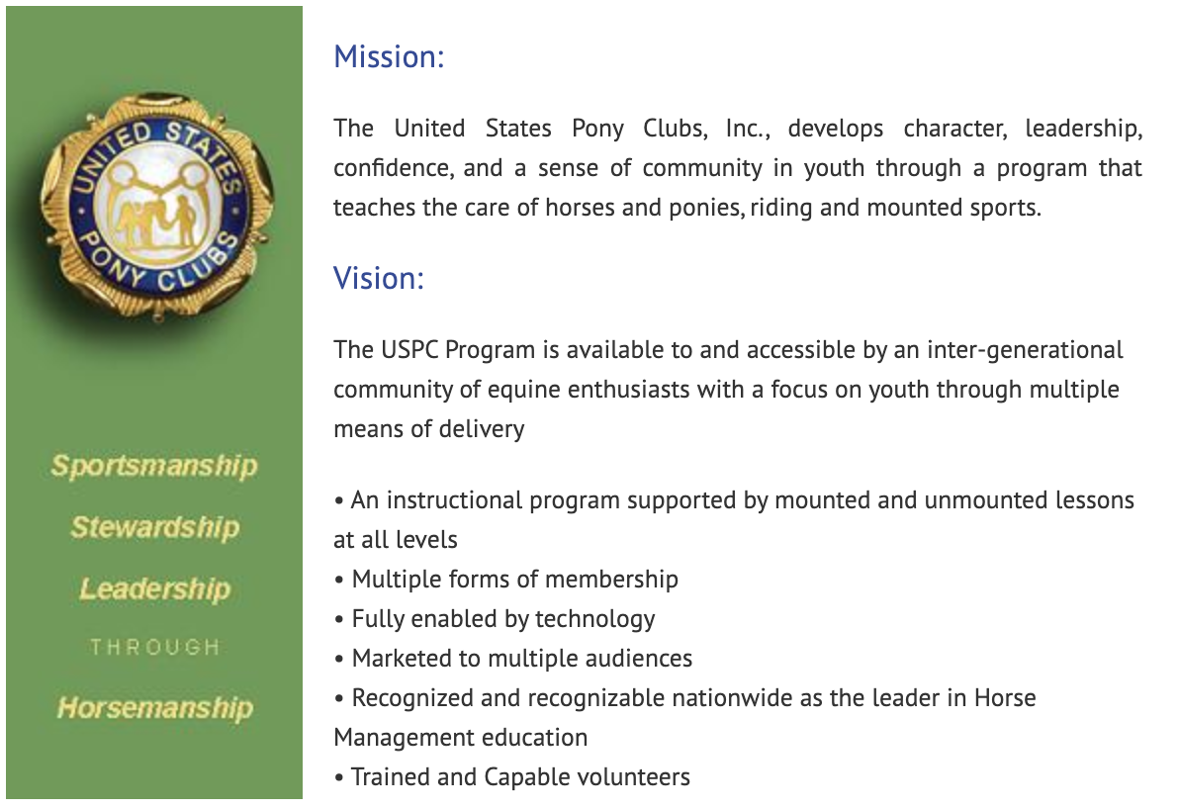
The United States Pony Clubs, Inc. is an educational organization which builds the foundations of teamwork and sportsmanship through riding, mounted sports, care of horses and ponies, while developing and enhancing leadership, confidence, responsibility, and a sense of community in its youth and adult members.
Why Statement:
The “Why” of USPC is to inspire and educate all generations to develop a sense of responsibility and respect for self, others, and their equine partners.

Slide 7
10:00am I. Call to Order (15 minutes)
a. Introductions
b. Adjustments to agenda if any
10:15am II. Old Business
a. USPC Mission and Vision (3 minute)
b. Presentation of 2020 Meeting Minutes (5 minutes) VOTE
c. Status of the Region (3 minutes)
d. D & I working group update
e. Special Awards update
f. Summary of Year’s Activities (20 minutes)
g. Volunteer Recognition (3 minutes)
h. USPC 2022 Equine Symposium & Convention (10 minutes)
i. National Youth Congress Delegates (10 minutes)

Slide 8
10:00am I. Call to Order (15 minutes)
a. Introductions
b. Adjustments to agenda if any
10:15am II. Old Business
a. USPC Mission and Vision (3 minute)
b. Presentation of 2020 Meeting Minutes (5 minutes) VOTE
c. Status of the Region (3 minutes)
d. D & I working group update
e. Special Awards update
f. Summary of Year’s Activities (20 minutes)
g. Volunteer Recognition (3 minutes)
h. USPC 2022 Equine Symposium & Convention (10 minutes)
i. National Youth Congress Delegates (10 minutes)

Slide 9
Who We Are
283 Member
234 in Clubs
49 in Centers
283 Member
207 Youth (under 26)
76 Adults
14 Clubs
HM Certification
3 H-HM 7 HB
22 C2 19 C1
37 D3 54 D2 29 D1
5 Centers
Mounted Certifications
1 A 2 B
4 C3 42 C2 30 C1
81 D3 122 D2 55 D1

Slide 10
Who We Are
Traditional
A - 1
B - 2
C3 -2
C+- 1
C2 - 16
C1 - 12
D3 - 33
D2 - 47
D1- 38
Dressage
C3- 1
C2 - 2
C1 - 2
C+ - 1
D3 - 6
D2 - 10
D1 - 4
Western
C2- 1
D3 - 1
D2 - 8
SJ
C2 - 19
C1 - 12
D3 - 33
D2 - 47
D1 - 1
HSE
C2- 4
C1- 4
D3 - 8
D2 - 10
D1- 12

Slide 11
10:00am I. Call to Order (15 minutes)
a. Introductions
b. Adjustments to agenda if any
10:15am II. Old Business
a. USPC Mission and Vision (3 minute)
b. Presentation of 2020 Meeting Minutes (5 minutes) VOTE
c. Status of the Region (3 minutes)
d. D &I working group update
e. Special Awards
f. Summary of Year’s Activities (20 minutes)
g. Volunteer Recognition (3 minutes)
h. USPC 2022 Equine Symposium & Convention (10 minutes)
i. National Youth Congress Delegates (10 minutes)

Slide 12
Diversity & Inclusion Working Group 2021 Summary
Formulated recommendations around helmet fit/safety, natural hair, and head coverings
Created and piloted (within the Region) a survey for the collection of demographic information from existing and new members, and shared that with the USPC executive director and board president in March 2021,
Supported the RS with a memo expressing our desire to work with the new board of governors' committee to roll out new policies coming from National.

Slide 13
The MidCal working group went on hiatus in April 2021, pending recommendations from the Board of Governors DIEA committee.
We are always looking for new working group members and particularly welcome interest from members, parents and supporters who represent demographic groups currently underserved by Pony Club.

Slide 14
10:00am I. Call to Order (15 minutes)
a. Introductions
b. Adjustments to agenda if any
10:15am II. Old Business
a. USPC Mission and Vision (3 minute)
b. Presentation of 2020 Meeting Minutes (5 minutes) VOTE
c. Status of the Region (3 minutes)
d. DEIA working group update
e. Special Awards update
f. Summary of Year’s Activities (20 minutes)
g. Volunteer Recognition (3 minutes)
h. USPC 2022 Equine Symposium & Convention (10 minutes)
i. National Youth Congress Delegates (10 minutes)

Slide 15
Special Award
The Essay Scholarship Fund of the Middle California Region is used to help members from the Region prepare for and offset costs related to attending mounted Regional activities.
In 2021 7 awards were given out.
Congrats to Caroline Jimenez, Naomi Jimenez, Margaret “Katie” Sachs, Clara Sachs, Joanna Sachs, of Fresno Pony Club and Andie Sue Roth (2x) of In The Irons Pony Club
For 2022 more opportunities for these awards will be shared, with Spring and Fall submissions available!
Encourage your membership to sign up for Regional events and to apply for this award!
Notes:
Charlotte/Rebecca

Slide 16
10:00am I. Call to Order (15 minutes)
a. Introductions
b. Adjustments to agenda if any
10:15am II. Old Business
a. USPC Mission and Vision (3 minute)
b. Presentation of 2020 Meeting Minutes (5 minutes) VOTE
c. Status of the Region (3 minutes)
d. DEIA working group update
e. Special Awards
f. Summary of Year’s Activities (20 minutes)
g. Volunteer Recognition (3 minutes)
h. USPC 2022 Equine Symposium & Convention (10 minutes)
i. National Youth Congress Delegates (10 minutes)

Slide 17
What We Did January - June
Virtual Palooza
MidCal
Virtual Quiz Rally
USPC
USPC Virtual Symposium & Convention
USPC
D Certification
Portola Valley PC
Tetrathlon Rally
Santa Cruz County PC

Slide 18
What We Did June - August
D - HM Virtual Lesson
C1/C2 Certification
South Bay Horse Ranch
USPC Championships & Festival
Lexington, KY
Pony Club Recognition Awards
The Horse Park at Woodside
D Camp
Santa Cruz County PC

Slide 19
What We Did September - November
Regional Annual Meeting
Virtual
D1/D2 Standards & Certification Clinic
Virtual
C1/C2 Certification
The Horse Park at Woodside

Slide 20
10:00am I. Call to Order (15 minutes)
a. Introductions
b. Adjustments to agenda if any
10:15am II. Old Business
a. USPC Mission and Vision (3 minute)
b. Presentation of 2020 Meeting Minutes (5 minutes) VOTE
c. Status of the Region (3 minutes)
d. DEIA working group update
e. Special Awards
f. Summary of Year’s Activities (20 minutes)
g. Volunteer Recognition (3 minutes)
h. USPC 2022 Equine Symposium & Convention (10 minutes)
i. National Youth Congress Delegates (10 minutes)

Slide 21
Middle California Region runs by the grace of it’s Volunteers. Pony Club wouldn’t be here without you.
Club Officers - DCs, JtDCs,Treasurers and Secretaries & Center Adminstrators
Middle California Region Advisory Board Members
VRS’s, Treasurer, Secretary, RIC’s and HMO, WebMaster/Social Media
Event Organizers- Instruction Clinics, Rallies, Certifications, Camps
Thank you for all you do!
A Special Step up Recognition
PVPC’s Linda Rossen for inviting regional members to their D level Certifications and Mattea Curtis for the Virtual HM Lessons

Slide 22
10:00am I. Call to Order (15 minutes)
a. Introductions
b. Adjustments to agenda if any
10:15am II. Old Business
a. USPC Mission and Vision (3 minute)
b. Presentation of 2020 Meeting Minutes (5 minutes) VOTE
c. Status of the Region (3 minutes)
d. DEIA working group update
e. Special Awards
f. Summary of Year’s Activities (20 minutes)
g. Volunteer Recognition (3 minutes)
h. USPC 2022 Equine Symposium & Convention (10 minutes)
i. National Youth Congress Delegates (10 minutes)

Slide 24
Leadership Training
Great Speakers
Workshops
Meeting of the Corporation
Research Fair
Trade Fair
Silent Auction
National Youth Congress
National Youth Board

Slide 25
10:00am I. Call to Order (15 minutes)
a. Introductions
b. Adjustments to agenda if any 10:15am II. Old Business
a. USPC Mission and Vision (3 minute)
b. Presentation of 2019 Meeting Minutes (5 minutes) VOTE
c. Status of the Region (3 minutes) d. Summary of Year’s Activities (20 minutes) e. Volunteer Recognition (3 minutes) f. USPC 2021 Equine Symposium & Convention (10 minutes) g. National Youth Congress Delegates

Slide 26
National Youth Congress Delegate
Jessica Flores

Slide 27
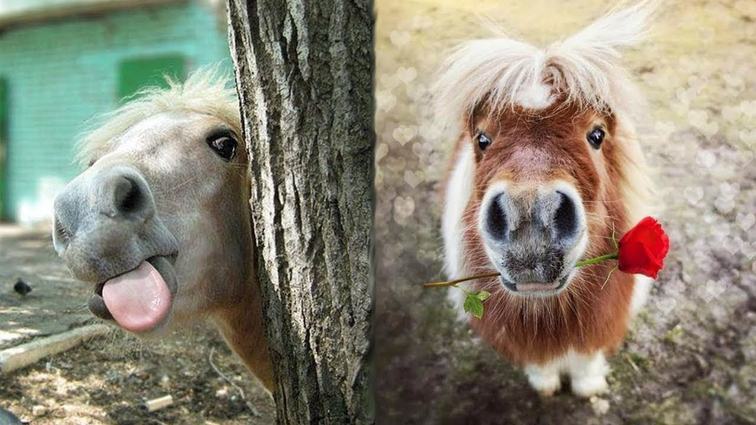
10 Minute
Break

Slide 28
11:15pm III. New Business- (35 minutes)
a. Nominating Committee presentation – Slate of Officers (10 minutes) VOTE
b. 2022 Nominating Committee (5 minutes) VOTE
c. Announcement of Organizers (5 minutes
d. Formation of Task Force (10 minutes)
i. Incentive Program for Rallying
ii. C Level Programs
iii. D Level Programs
e. Treasurer’s Report for 2021 (5 minutes)

Slide 29
2021 Nominating Committee
Joanna Sachs (Chair)
Jackie Anderson
Thank You!

Slide 30
Proposed 2022 Slate of Officers
Regional Supervisor Bess Pieracci
VRS of Administration Kathie Schulz
VRS Membership Barbie Roth
VRS Activities Nichole Fisher
Horse Management Organizer Eben Haber
Regional Instruction Coordinator
Rebecca Taylor & Charlotte Arrouye
Treasurer Deb Kirsch
Secretary Melissa Myers

Slide 31
11:15pm III. New Business- (35 minutes)
a. Nominating Committee presentation – Slate of Officers (10 minutes) VOTE
b. 2022 Nominating Committee (5 minutes) VOTE
c. Announcement of Organizers (5 minutes)
d. Formation of Task Force (10 minutes)
i. C Level Programs
ii. D Level Programs
e. Treasurer’s Report for 2021 (5 minutes)

Slide 32
2022 Nominating Committee
Nominations from the floor
Must be a Club/Center leader in 2022

Slide 33
11:15pm III. New Business- (35 minutes)
a. Nominating Committee presentation – Slate of Officers (10 minutes) VOTE
b. 2022 Nominating Committee (5 minutes) VOTE
c. Announcement of Organizers (5 minutes)
d. Treasurer’s Report for 2021 (5 minutes)

Slide 34
2021 Organizers & Appointees
Communications:
Social Media/Webmaster - Michelle Cale
Certifications:
National Certifications - Melissa Myers
Region C1/C2 Certifications - Molly Johnson
Camps:
D Camp - Nicole Fisher
C Camp - Volunteer?
Rallies:
Dressage - Juliet Clark
Quiz - Kathie Schulz
TET - Nichole Fisher
D Rally - Melissa Myers
Ribbons:
All Rallies - Volunteer ?

Slide 35
11:15pm III. New Business- (35 minutes)
a. Nominating Committee presentation – Slate of Officers (10 minutes) VOTE
b. 2022 Nominating Committee (5 minutes) VOTE
c. Announcement of Organizers (5 minutes
e. Treasurer’s Report for 2021 (5 minutes)

Slide 36
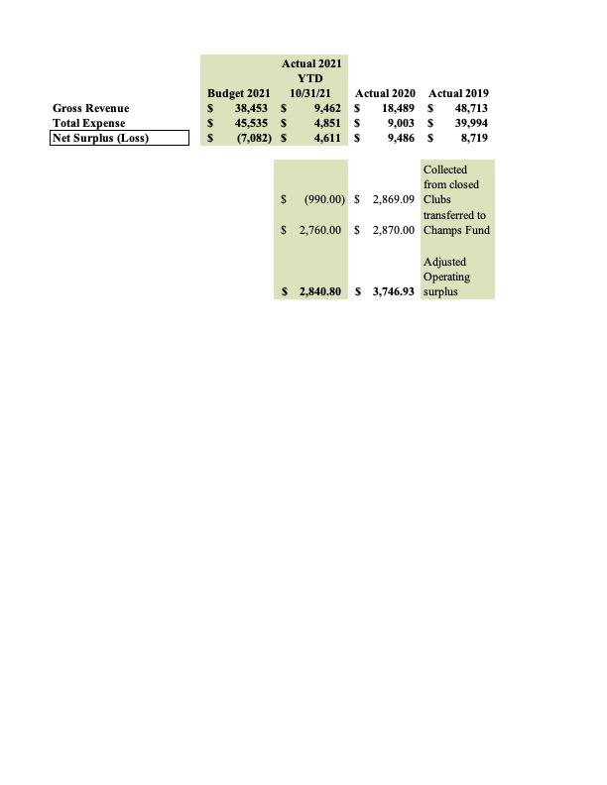
2021 Treasurer’s Report

Slide 37
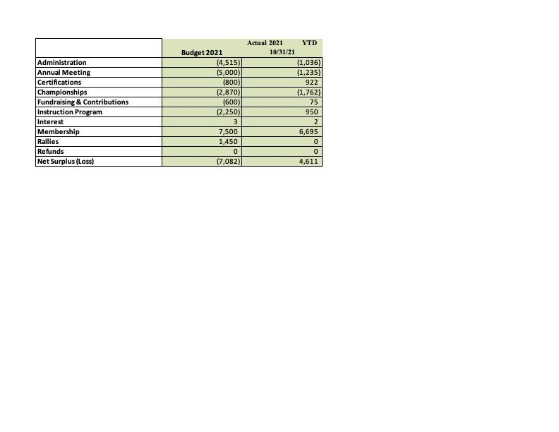
2021 Treasurer’s Report

Slide 38
2021 Treasurer’s Report
Balance Sheet
Checking Account: $15,795.50
Savings Account: $26,012.96
Total Assets: $41,807.46
Total Liabilities & Equity: $41,807.46
Fund Balances
Championships Fund: $13,330.00
Operating Fund: $8,669.09
Total Restricted Funds: $21,999.09

Slide 39
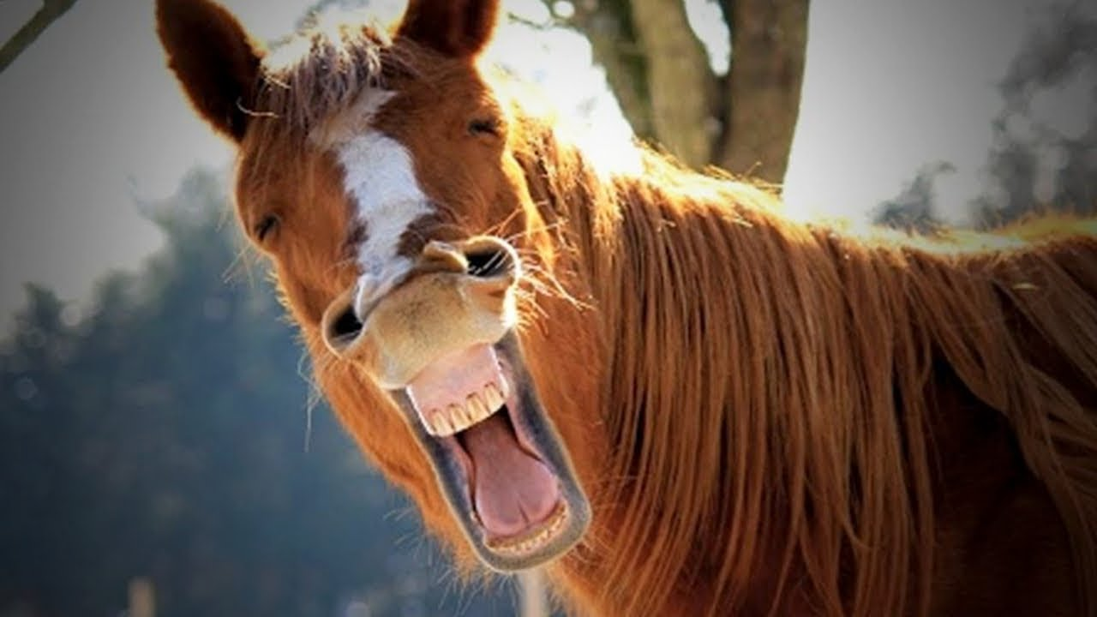
30 Minute Lunch Break

Slide 40
12:45pm IV. Financial Planning - (66 minutes)
a. Philosophical Discussion (10 minutes)
i. How do we fund things? Any changes now for 2023?
b. Proposed 2022 Budget - Discussion and Vote (30 minutes)
c. Mid Cal Procedures and Guidelines
i. RIC Report (10 minutes)
ii. Review – Procedures for Organization, Registration and Payment of Regional Events (10 minutes)
iii. Review – Conflict Resolution (3 minutes)

Slide 41
12:45pm IV. Financial Planning - (66 minutes)
a. Philosophical Discussion (10 minutes)
i. How do we fund things? Any changes now for 2023?
b. Proposed 2022 Budget - Discussion and Vote (30 minutes)
c. Mid Cal Procedures and Guidelines
i. RIC Report (10 minutes)
ii. Review – Procedures for Organization, Registration and Payment of Regional Events (10 minutes)
iii. Review – Conflict Resolution (3 minutes)

Slide 42
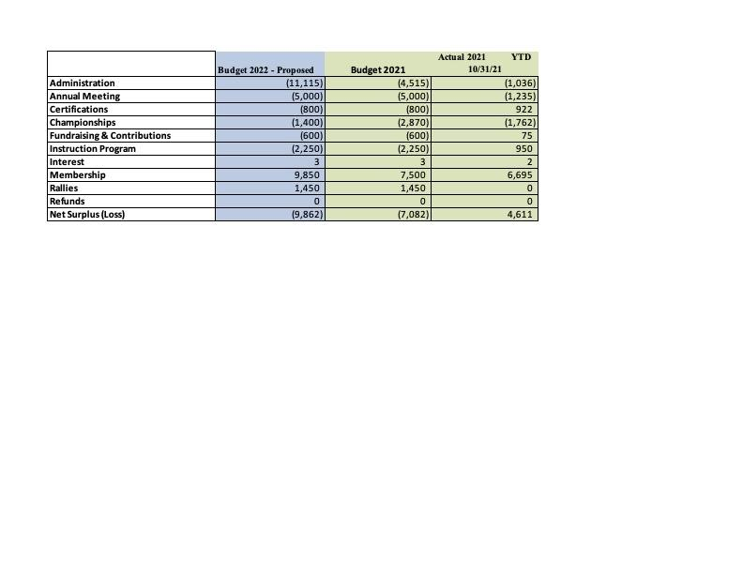
2022 Budget Proposal
(10, 315)
(1,600)
Notes:
Reduced regional dues
$5k for annual meeting and ending in deficit
Funding for contest is in budget

Slide 43
12:45pm IV. Financial Planning - (66 minutes)
a. Philosophical Discussion (10 minutes)
i. How do we fund things? Any changes now for 2023?
b. Proposed 2022 Budget - Discussion and Vote (30 minutes)
c. Mid Cal Procedures and Guidelines
i. RIC Report (10 minutes)
ii. Review – Procedures for Organization, Registration and Payment of Regional Events (10 minutes)
iii. Review – Conflict Resolution (3 minutes)

Slide 44
Regional Instructor Coordinator(RIC) OVERVIEW & UPDATE
Rebecca Taylor and Charlotte Arrouye
Notes:
Charlotte/Rebecca

Slide 45
RIC: 2021 Overview
Accomplished this year (2021)
Website update under forms > DC/CA with:
Reference/Guideline for the Use & Compensation of the Upper-Level Members
Upper Level Members(C1+): Instruction/Examiners sheet
+ Updated list of attendees from recent S&C Clinics
RIC update email detailing:
Detailed outline of Club/Center resources for instruction and certifications and our contacts for support
Opportunity to sign up for teaching to teach programs/junior instructors program
Biennial Pony Club Palooza - Spring Event
Wonderful all day HM extravaganza with tracks for D, C , H-B/H-A, and leadership with over 15 sessions featuring 9+ speakers/presenters from within our Pony Club organizations as well as outside groups
Spring (virtual) D1/D2 Standards and Certification Clinic
Spring (virtual) D3-C2 Standards and Certification Clinic
Fall (virtual) D1/D2 Standards and Certification Clinic / “Examiner Training” Clinic
Notes:
Charlotte/Rebecca

Slide 46
RIC: Standards and Certifications
Have new instructors teaching for your club? Working with examiners for local level testings?
Attend a Standards and Certifications Clinic led by Rebecca!
All clubs/center in our Region should look to send at least one representative to the clinic. If you are a leader, please be sure to encourage all of your instructors and examiners to attend!
To be a Pony Club examiner you MUST attend a S&C Clinic at least once every two years.
We offer clinics focused on the local level D-1 through C-2
Notes:
Charlotte/Rebecca

Slide 47
RIC: Club/Center Meeting Calendar
Wondering how to form a meeting calendar for the year?
We would love to work with each Club/Center to in helping you form a calendar for mounted/unmounted instruction.
Charlotte will be reaching out to you all by email with resources and we are here to help guide you if you have any questions!
Notes:
Charlotte/Rebecca

Slide 48
RIC: Junior Instructor Program
Junior Instructor Program: This took a back burner due to COVID in 2020 & 2021.
This is a pathway to help our C’s learn how to teach, then get experience teaching, and finally be signed off as “ready to teach” specific levels.
The Jr. Instructors will be listed by what they’ve been signed off (for example “D1/D2/D3 unmounted, D1/D2 trad mounted”)
The “Junior Instructors” will be required to attend/participate in the S&C Clinics
C1 level members should go to the D level S&C, C2 and HB level members should attend both the D and C level clinics
Charlotte will send out an email with our 2022 RIC update for DCs/CAs to sign up and explain need/interest
*Clubs/Center leaders need to contact Rebecca if they have interested members
PLEASE MAKE SURE TO TAKE ADVANTAGE OF THIS WITH OUR VISITING RICs PROGRAM

Slide 49
RIC: Junior Instructor Program Con’t
Charlotte will send out an email with our 2022 RIC update for DCs/CAs to sign up and explain need/interest
The program involves the UL member working with a mentor
The UL member has a “gradual release of responsibility” as they become more confident and skilled with their teaching
The “mentor” can be Rebecca Taylor - or someone local with the club, and Rebecca will work with them to understand the program goals
The goal is to have experienced and qualified instructors for the clubs, AND candidates with experience passing their certifications!
*Clubs/Center leaders need to contact Rebecca if they have interested members
PLEASE MAKE SURE TO TAKE ADVANTAGE OF THIS WITH OUR VISITING RICs PROGRAM

Slide 50
RIC: Updates continued..
Goals for next year(2022)
Visiting RICs: we are coming to your club/center!
We would like to make sure one of the RICs is hired to teach for one of your Pony Club meetings in 2022
This is to ensure your club/center has the opportunity to receive instruction that is deeply rooted in the Pony Club curriculum
From safety checks to warm up discussions to exercises closely centered around the SOPs
On the meeting that the RIC is coming to your club/center, we will work with you leaders to build a lesson schedule that day that offers a teaching to teach opportunity for your upper level members in the ring/HM
This is a also great opportunity for leaders to observe qualities of instructors when you are hiring others, especially though outside of Pony Club(remember to have them attend a S&C Clinic) and a reminder of how to make your meetings truly and uniquely Pony Club experience.
Notes:
Charlotte/Rebecca

Slide 51
RIC: Updates
Goals for next year(2022)
Website resources
Update list of S&C attendees and C1+ members interested in teaching/being examiners with club/center needs
Gather larger list of existing club/center instructors/examiners with areas served for larger accessibility
RIC Update Email
Continue to educate clubs/centers about Pony Club resources for instruction and certifications and offer support in building a meeting calendar
D-1/D-2 & D-3 through C-2 Standards and Certification Clinic and “Examiner Training”
Important for instructors & examiners, “Examiner Training” portion is great for new D1/D2 examiners
A virtual “how to do a testing” session, including discussion around standards with pictures and videos
Goal to offer an in person clinic again as we are able to manage COVID more
UL (C3/HB/HA/B/A Prep Clinics: Mounted & HM)
Clubs with UL candidates contact Rebecca w/interest so she knows what to plan for
Visiting RICs and Junior Instructor Program
Teaching to teach opportunities for your Club/Center led by your RICs, seasoned instructors and examiners
Notes:
Charlotte/Rebecca

Slide 52
Rallies
Club/Center Fundraising Rally
Any Club/Center may run a rally or other type of Pony Club event to serve as a fundraiser for themselves and take on the Administration of the Rally. (Administration includes, registration and collecting of money)
Regional Rallies
The Region orders and maintains the Ribbons for all Rallies
All registrations for Rallies will be done through the Club/Center not individually

Slide 53
Non-Rallies
Regional Clinics and Certifications
Members may register as individuals or though Club/Center
Club/Center and Personal checks will be accepted
Members may also pay fees using PayPal but 2.5% must be included to cover PayPal fees
The use of Paypal needs prior approval of the Regional Treasurer

Slide 54
Conflict Resolution
If between members - consult DC
if unresolved DC contacts RS
If between DC and members, contact the RS
The RS will notify and may consult the director of regional administration about any conflicts and how they are resolved
If there is a conflict with the RS, the director of regional administration should be contacted
Keep written documentation of events and conversations
Save emails and text threads that are related

Slide 55
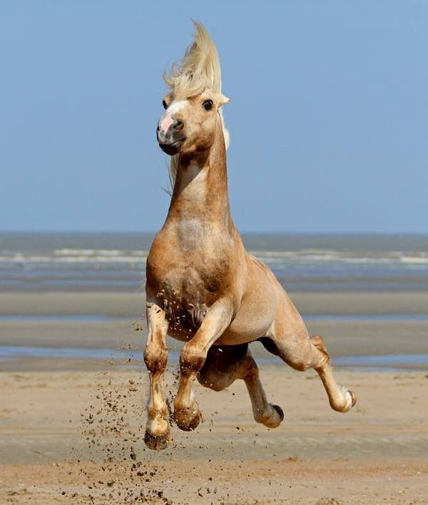
10 Minute
Break

Slide 56
2:00 pm V. Presentation and Discussion of 2022 (30 minutes)
2:30pm VI. Other Business (20 minutes)
a. USPC Annual Fund (3 minutes)
b. Other?
3:00 pm VII. Adjournment

Slide 57
2022 Middle California Region Calendar
January
Sunday 1/23 or In Person Peer Review Workshop
Organizer: Deb Kirsch from Region
Location: TBD In person (+ maybe virtual component?)
26 - 30 USPC Annual Meeting, Norfolk VA
February
Saturday 2/12 Virtual Officer Training
Organizer: Kathie S. from Region
Location: Virtual
TBD: Asking for 2/26 or 3/5 Qualifying Quiz Rally - Milpitas, Bay View, Golden Hills, Others?
Organizer/Fundraising Club: Kathie S, Bay View PC
Location: Milpitas
March
3/19 & 3/20 Qualifying Dressage Rally(+ potential schooling show), South Bay Horse Ranch
Organizer/Fundraising Club: Juliet Clarke, Golden Hills PC
Location: South Bay Horse Ranch, Gilroy
TBD - (3/26? or early April?) S & C Clinics
Organizer: RICs from Region
Location: In Person TBD Redwood Hills, Oakland

Slide 58
2021 Middle California Region Calendar
April
FYI: 4/9 - Celebration of Life, Mount Diablo Trail Ride Assc., Valerie Sterling Clayton Canyon PC
TBD EBTH(Everything But The Horse) Rally *non-qualifying*
Organizer: TBD
Location: TBD Glenoaks Stables PCRC, Portola Valley or In The Irons PC(?)
TBD - up for discussion Regional C Prep (Lounging+Mounted(DR, HSE, EV FL+Stadium)
Organizer: Melissa Myers
Location: TBD: Fresno / Twin (Barbie’s place?)
TBD- up for discussion Regional C Prep HM
Organizer: TBD - RICs
Location: TBD- Virtual
May
5/6 -5/ 8(Mother’s day) D (Mock) Rally Black Ridge *non-qualifying*
Organizer: Melissa Myers of Black Ridge PC
Location: Fresno Horse Park, Eden Ranch Fresno
TBD 5/14-5/15 or 6/3-6/4 C1/C2 Regional Certification - Location & Organizer?
Organizer: TBD
Location: TBD Sky Valley Training PCRC? (Molly following up)
5/21-5/22 Tetrathlon “TET” Rally, Santa Cruz Co. PC Qualifying Rally
Organizer: Nicole Fisher, SCC PC
Location: TBD - Marina?
June
6/3-6/ 4 Trail/Western 2 Day Clinic, Clayton Canyon PC at CMDTRA
Organizer: Valerie Sterling, Beth Scroggs, Clayton Canyon PC
Location: Concord Mount Diablo Riding Association, Clayton.
TBD on date Sales Booth at the Spac-Tack-ler at HPW
Organizer: TBD - Charlotte if before 6/15? Woodside PC? - need to reach out and ask
Location Woodside Horse Park
TBD on dateC Camp
Organizer:
Location

Slide 59
2022 Middle California Region Calendar
July
Western Championships (In CA and hoping to move the date to early July)
TBD - end of July D Camp
Organizer: Nichole Fisher
Location Marina Equestrian Center (camping?)
August
Pony Club Recognition at Woodside Event? (issues with having this at Woodside?)
Organizer: ??
Location: Woodside Event
September
Standards and Certification (Virtual? In person?)
Organizer: Charlotte and Rebecca
Location: TBD?

Slide 60
2022 Middle California Region Calendar
October
Oct 21-23 Pony Club Recognition at Fresno Event?
Organizer: Melissa Myers?
Location: Fresno Event
Oct 15 or 16 C1/C2 Certification
Organizer: Molly Johnson
Location: Woodside
Oct 28-30 National Certification (in conjunction with Sierra Pacific)
Organizer: Melissa Myers
Location: Fresno area? Eden?
November
November 13 Regional Annual Meeting

Slide 61
2:00 pm V. Presentation and Discussion of 2022 (30 minutes)
2:30pm VI. Other Business (20 minutes)
a. USPC Annual Fund (3 minutes)
b. Other?
3:00 pm VII. Adjournment

Slide 63
2:00 pm V. Presentation and Discussion of 2022 (30 minutes)
2:30pm VI. Other Business (20 minutes)
a. USPC Annual Fund (3 minutes)
b. Other?
3:00 pm VII. Adjournment

Slide 64
Other - Changes for 2022: Member Protection
Per Policy 0900, USPC requires all volunteers holding a leadership position within Pony Club to complete the Member Protection Training.
***NOTICE OF NEW BACKGROUND CHECK & MEMBER PROTECTION TRAINING REQUIREMENTS - Effective January 1, 2022***
Adult Participating Member (18 years of age and over):
Effective January 1, 2022, Club, Center, and National Members of USPC age 18 and over, will be required to provide proof of SafeSportTM Trained Course completion.
In addition, all member of USPC aged 21 and over, will be required to complete a favorable USPC background check.
Pony Club Instructors and Other Volunteers:
Regular instructors and volunteers having ongoing contact with members will soon be required to complete both a favorable USPC background check and provide proof of SafeSportTM Trained Course completion.
NOTE: If you have completed the SafeSportTM Trained Course through USEF or another sports organization, you may email your proof of completion to the Compliance Coordinator who will record your completion of the training in your USPC record.
Notes:
https://www.ponyclub.org/Volunteers/Safety/YouthProtection.aspx

Slide 65
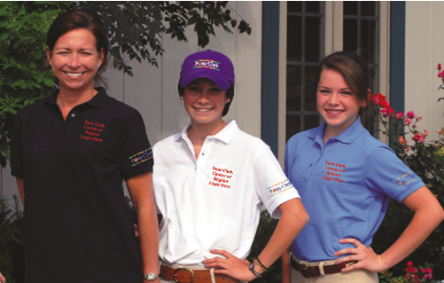
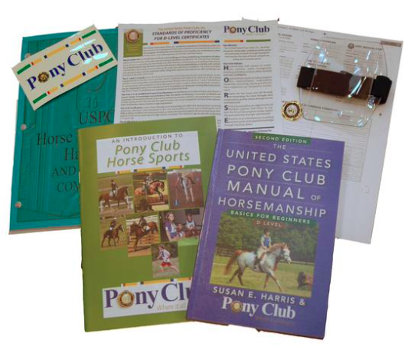
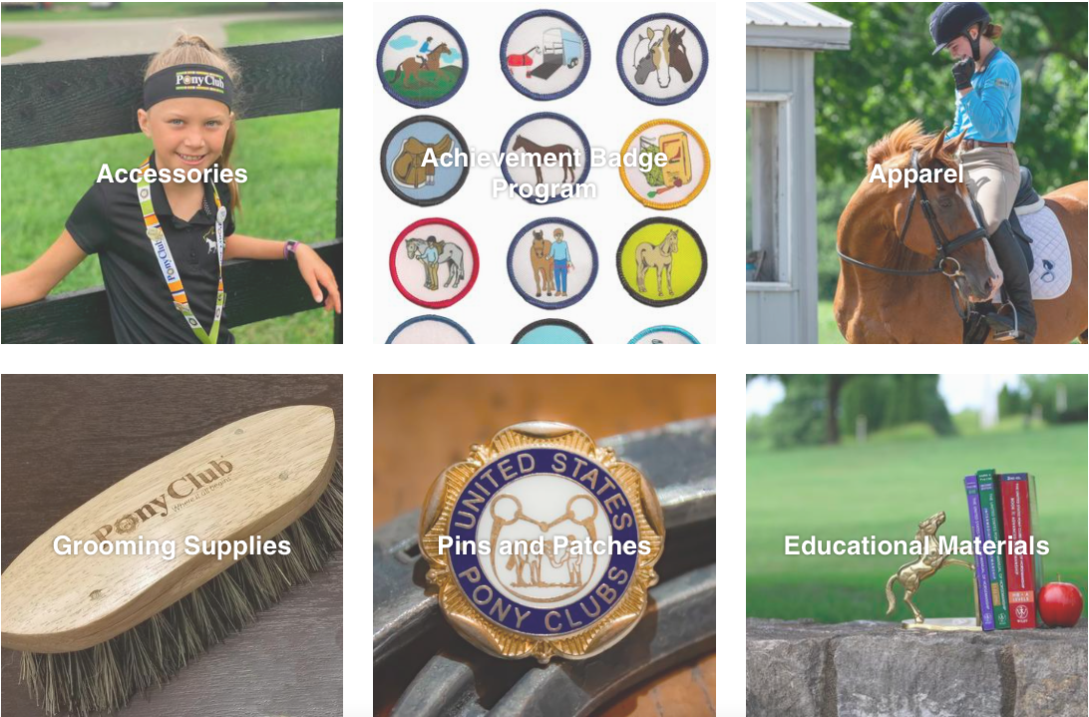
Other - Shop Pony Club
ShopPonyClub.org
All the needs for your club/center meetings and rally attendance!
Custom Pony Club Polos, New Member Starter Kit and so much more.
Pony Club Polos
New Member Starter Kit
Accessories
Achievement Badges
Apparel
Grooming Supplies
Pins & Patches
Educational Materials

Slide 66
Thank You!

